Slide 1
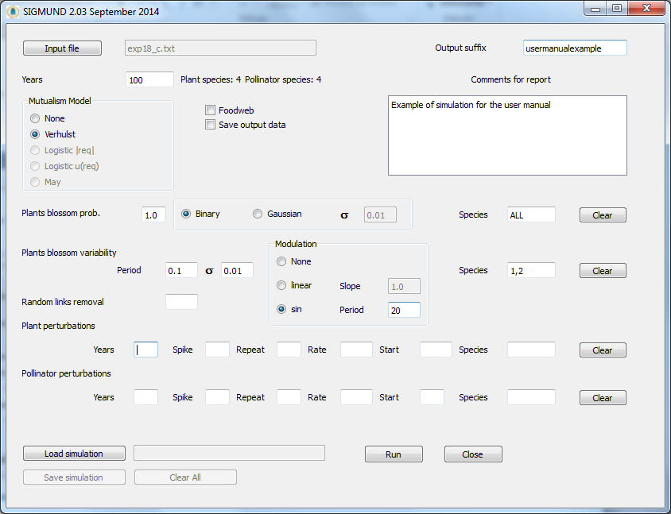
Choose input file
Optional suffix to be appended to output files
Optional user
comment
Perturbations
Load/store simulation
parameters

